Slide 1
WINDOWS BYPASSING AUTHENTICATION
Guide Name:
Mr.Prabanjan

Slide 2
TEAM MEMBERS
1.Meesala Jaswanth - 20R21A6218
2. Eligeti Harshitha - 20R21A6212
3. Aerolla Ruben - 20R21A6203
4. A. Bhuvann Reddy - 20R21A6201

Slide 3
OBJECTIVE:
Windows Bypassing Leads Involves Gathering Information From The Target ,Intrusion Into Important Servers Stealing Confidential Information.
It will be Easy For The Hacker To Bypass The Windows Without The Victim Knowing Using kon-boot Software.

Slide 4
ABSTRACT:
Windows Authentication Bypassing is an attack where attacker can go into others personal laptops or systems without knowing their password for their windows system. Bypassing is a thing which is not always detected and blocked, so it will be easy for the hacker to bypassing windows authentication without the victim known. This leads to gathering information from the target, intrusion into important servers stealing confidential information

Slide 5
EXISTING SYSTEM
In Previous We had Different Types Of Methods That Can Be Used To Bypass Windows, Such As:
1. USB BOOT
2. CD BOOT
3. PC Unlocker
4. iSeePassword - windows password revovery pro
5. John the ripper
6. iSunshare Windows 10 Password Genius

Slide 6
PROPOSED SYSTEM:
The Main Objective Of the Proposed System is :
To Bypass Windows Authentication.
To Retrieve essential data from a device without knowing the password.
To Spread the solution for windows bypassing.
To Easily bypass using a usb in less than five minutes.

Slide 7
HARDWARE REQUIREMENTS:
The hardware requirements to perform windows authentication bypassing:
1.Supported Operating System : Windows XP to Windows 112.
2.Processor : Pentium III compatible processor (min)3.
3.Hard Drive (USB) : 10 Mb free space (min)4.
4.Others : Internet to download/ burn the file.

Slide 8
SOFTWARE REQUIREMENTS :
KON-BOOT
GITHUB

Slide 9
STRENGTHS:
We can hack into any windows operating system that has MSDT.
We don’t have to re-upload the document file every time.
As of now, we don’t have the official patch. So,it can be exploited.(As of time we created)

Slide 10
WEAKNESS:
An Attacker With Clear Intension And Purpose To Steal Information From a Specific Organisation or a person
The Privacy Is The main Consern For Windows.

Slide 11
OPPORTUNITIES:
By doing Windows Bypassing we get to know the vulnerabilities.
We will be checking the security considerations.
There will be potential impact.

Slide 12
THREATS:
You can use hard disk encryption software like FileVault (Apple)/Bitlocker (Microsoft) / TrueCrypt or set BIOS/UEFI password in order to stop other people from using Kon-Boot on your computer.

Slide 13
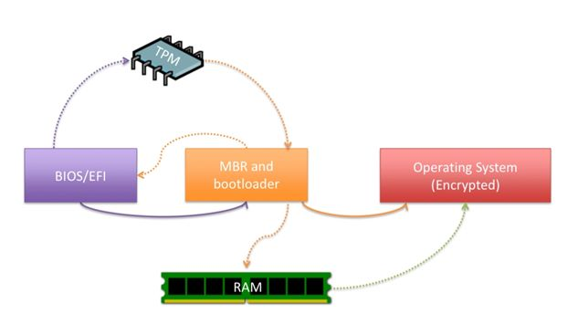
ARCHITECTURE:

Slide 14
WORKING:
The source code of Kon-boot has not been published by its author so it is not known what it does exactly to hack the operating system.
However some hypothesis can be made based on known technologies to determine how it works. In general, bootkits basically hook the 0x13 interruption routine that is usually provided by the BIOS of the computer.
The role of this routine is to read sectors from the hard disk and to load them into a given location in RAM memory.
By hooking this routine, bootkits such as Kon-boot or Vbootkit modify directly the code of the operating system when it is copied into main memory, just before its execution.

Slide 15
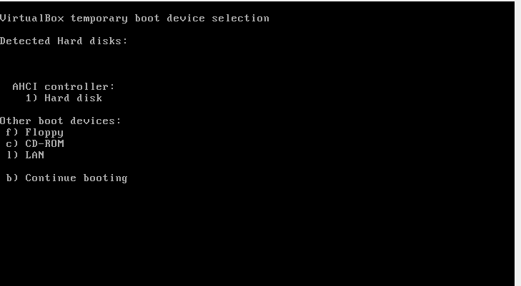
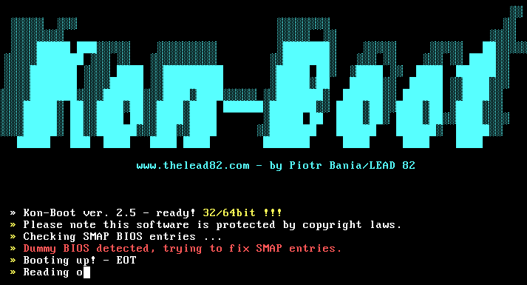
EXECUTION:
After installing Kon-boot software to the USB, insert the USB to the locked system.

Slide 16
CONCLUSION:
IT IS IMPORTANT TO ENABLE SECURITY FUNCTIONS, BUT TO IMPLEMENTMULTI
LAYERED DEFENCE, SUCH AS STRENGTHENING MONITORING, THISCAN DECREASE
THE CHANCE OF BYPASSING WINDOWS

Slide 17


